Slide 1
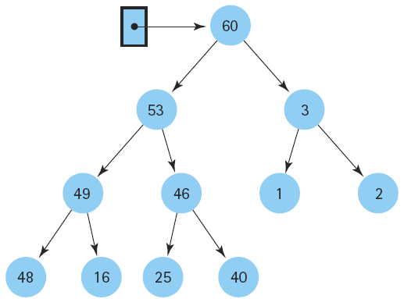
Data Structures & Algorithms
Week1

Slide 2






Well Come TO ALL STUDENTS IN 4th SEMESTER

Slide 3
CS423 DSA
BSCS/BSIT
Classes and Lab

Slide 4
Quizzes & Assignmentsrse Evaluation
Quizzes –% (4-5 Quizez best of 4 will be Counted)
Assignments –% (4-5 Assignments best of 4 will be Counted) – (Tasks weightage)
Presentations – % (Individual Presentation)
Mid Term
Final % (All Course)
Same grading applies for Lab as well

Slide 5
Project Presentation Policies
Project will be from Data Structure domain.
Student may choose the presentation and approve it from teacher else teacher will assign the topic.
Individual or group presentation will be taken.
Discussion and questions will be asked.
Volunteer presentations (you may not be that familiar with this kind of stuff but you need to respond to it quickly!)

Slide 6
Grading Policy: (Tentative)
18 Mid Tem Exam
30 Final Theory Exam
20 Final Practical Exam
12 Quizzes and Assignments

Slide 7
Data Structure
Data:
Are simply a value are set of values of different type which is called data types like string, integer, char etc.
Structure:
Way of organizing information, so that it is easier to use.
So
Its a way organizing data in such a way so that data can be easier to use.
●

Slide 8
Data Structure
Data Structure ..
A data structure is a particular way of organizing data in a computer so that it can be used efif ciently.
A scheme for organizing related pieces of information.
●

Slide 9
Why Data Structure
Human requirement with computer are going to complex day by day. To solve the complex requirements in efficient way we need this study.
Provide fastest solution of human requirements. Provide efficient solution of complex problem.
Space
Time
●
●
●

Slide 10
Study in Data Structure
●
Logical or
mathematical description of the
structure.
Implementation of structure on a computer
●
using different computer languages ( C, C++, JAVA, pl-languages etc.)
Qunatitative analysis of the structure, which includes determining the amount of memory needed to store the structure and the time required to process the structure.
●

Slide 11
Classification of Data Structure
Data Structure
Simple Data Structure
Compound Data Structure
Integer
Float
Character Pointer
Linear Data Structure
Non-Linear Data Structure
Array
Linked List
Stack
Queue
Tree
Graph
Files

Slide 12
Classification of Data Structure ...
●
Simple Data Structure: Simple data structure can be constructed with the help of primitive data structure. A primitive data structure used to represent the standard data types of any one of the computer languages (integer, Character, float etc.).
●
Compound Data Structure: Compound data structure can be constructed with the help of any one of the primitive data structure and it is having a specific functionality. It can be designed by user. It can be classified as Linear and Non-Linear Data Structure.
.

Slide 13
Classification of Data Structure ...
Linear Data Structures: A linear data structure traverses the data elements sequentially, in which only one data element can directly be reached. Ex: Arrays, Linked Lists
Non-Linear Data Structures: Every data item is attached to several other data items in a way that is specific for reflecting relationships. The data items are not arranged in a sequential structure. Ex: Trees, Graphs
●
●

Slide 14
Operation on Linear/Non-Linear Data Structure
Add an element Delete an element Traverse / Display
Sort the list of elements Search for a data element
●
●
●
●
●

Slide 15
Types of Data Structure
Array: is commonly used in computer programming to mean a contiguous block of memory locations, where each memory location stores one fixed-length data item. e.g. Array of Integers int a[10], Array of Character char b[10]
●
Array of Integers
0 | 1 | 2 | 3 | 4 | 5 | 6 | 7 | 8 | 9
5 | 6 | 4 | 3 | 7 | 8 | 9 | 2 | 1 | 2
Array of Character
0 | 1 | 2 | 3 | 4 | 5 | 6 | 7 | 8 | 9
5 | 6 | 4 | 3 | 7 | 8 | 9 | 2 | 1 | 2

Slide 16
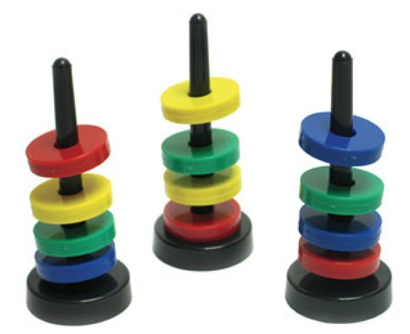
Types of Data Structure ...
Stack: A stack is a data structure in which items can be inserted only from one end and get items back from the same end. There , the last item inserted into stack, is the the first item to be taken out from the stack. In short its also called Last in First out [LIFO].

Slide 17
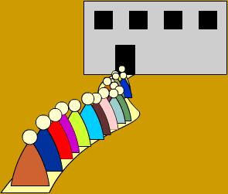
Types of Data Structure ...
Queue: A queue is two
in be
ended data structure which items can
inserted from one end and taken out from the other end. Therefore , the first item inserted into queue is the first item to be taken out from the queue. This property is called First in First out [FIFO].

Slide 18
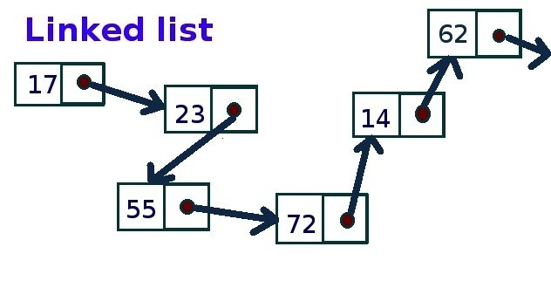
Types of Data Structure ...
Linked List: Could alternately used to store items. In linked list space to store items is created as is needed and destroyed when space no longer required to store items. Hence linked list is a dynamic data structure space acquire only when need.

Slide 19
Types of Data Structure ...
Tree: is a non-linear data structure which is mainly used to represent data containing a hierarchical relationship between elements.
Binary Tree: A binary tree is a tree such that every node has at most 2 child and each node is labeled as either left of right child.

Slide 20
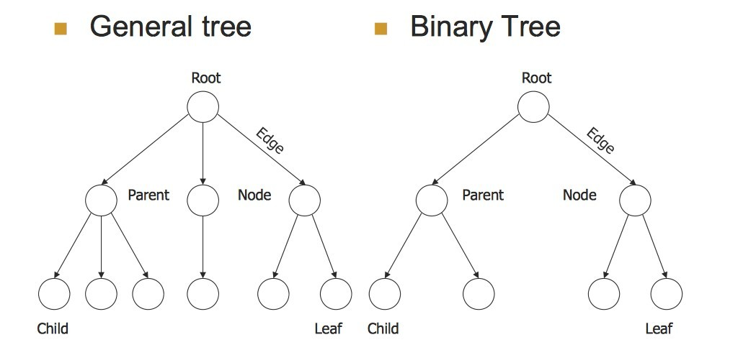
Types of Data Structure ...

Slide 21
Types of Data Structure ...
Graph: It is a set of items connected by edges. Each item is called a vertex or node. Trees are just like a special kinds of graphs. Graphs are usually represented by G = (V, E), where V is the set vertices and E is the set of Edges.

Slide 22
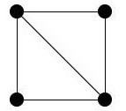
Types of Data Structure ...
Undirected Graph: A graph whose edges are unordered pair of vertices. That is each edge connects two vertices. In an undirected graph, direction is not important, if the path is available, it can be traversed in any direction.

Slide 23
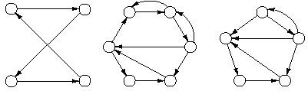
Types of Data Structure ...
Directed Graph: In directed graph a directional edge connect two node/vertex. If there is one edge from one vertex to other then only this path can be followed.

Slide 24
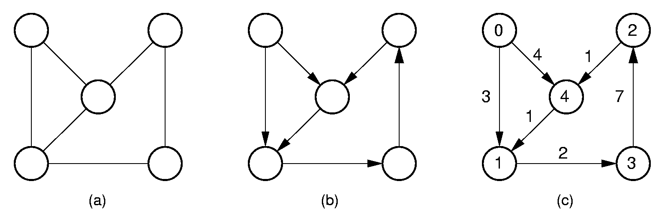
Types of Data Structure ...
Weighted Graph: A graph having a weight, or number associated with each edge

Slide 25
Selecting a Data Structure
Analyze the problem to determine the resource constraints a solution must meet.
Determine the basic operations that must be supported. Quantify the resource constraints for each operation.
Select the data structure that best meets these requirements.
●
●
●

Slide 26
Algorithm
Algorithm:
A computable set of steps to achieve a desired result
Relationship to Data Structure
Example: Find an element
2
4
6
1
3
5
7
1
2
3
4
5
6
7

Slide 27

Algorithm

